Slide 1

Fundamentals of Data Security
maxgrowth
By Prof.Vishal Chugh

Slide 2
What is Data Security ?
Data security is the practice of protecting digital information from unauthorized access, corruption or loss throughout its entire lifecycle

Slide 3
Process to Secure and Access the Data
Encryption
Decryption
Encryption is the process of converting information into a coded format, making it unreadable to anyone without the proper key
It is the process of converting encrypted data back into its original, readable form

Slide 4
Major types of Encryption used in Industry
Symmetric
Asymmetric
A single secret key is used to encrypt and decrypt data.
Uses a pair of keys: a public key that can be shared with anyone for encryption and a private key that must be kept secret for decryption.

Slide 5
Pros
Symmetric
Asymmetric
Generally faster and more efficient than asymmetric encryption, making it suitable for encrypting large amounts of data.
Offers better security for key distribution, as the private key never needs to be shared.

Slide 6
Cons
Symmetric
Asymmetric
Requires secure key distribution, as the same key must be shared between the sender and recipient.
Generally slower and less efficient than symmetric encryption, making it less suitable for large data volumes.

Slide 7
Encryption in Python
maxgrowth
By Prof.Vishal Chugh

Slide 8

Import the Fernet from Cryptography

Slide 9
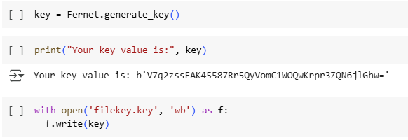
Generate Key and store it in .key file

Slide 10
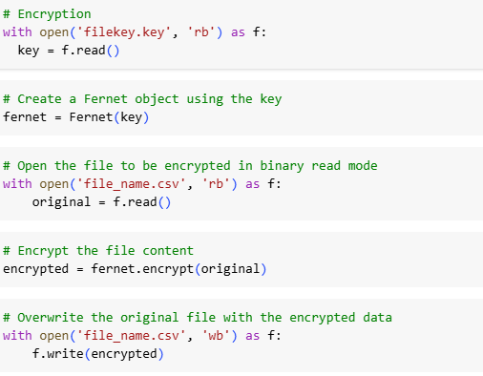
Create Encryption

Slide 11
Decryption in Python
maxgrowth
By Prof.Vishal Chugh

Slide 12
Import the Fernet from Cryptography

Slide 13
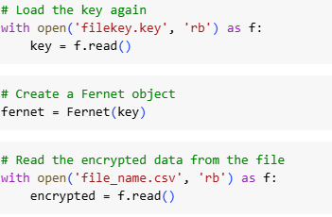
Load .key file and encrypted data file

Slide 14
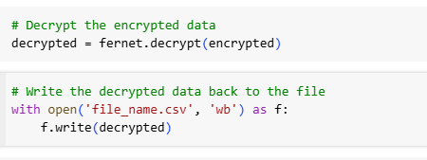
Create Decryption

Slide 15
Common Steps in Python
max growth
By Prof.Vishal Chugh

Slide 16
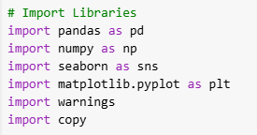
First Step Import Necessary Libraries

Slide 17

Load data in dataframe using pandas

Slide 18

See the first 5 rows and last 5 rows of data

Slide 19

Inspecting the data types of all columns

Slide 20

Inspecting the number of rows and column

Slide 21

Inspecting the Duplicate Records

Slide 22

Inspecting the missing values

Slide 23

Creating copy of the original dataset

Slide 24

Creating Box Plot in missing values column to see outliers

Slide 25
For numeric data without outliers we use mean to fill missing values

Slide 26
For numeric data with outliers we use Median to fill missing values

Slide 27
For Categorical data we use mode to fill missing values

Slide 28
Case Study
max growth
By Prof.Vishal Chugh

Slide 29
Case Study: Customer Persona for "TrendMart"
Background
TrendMart is a retail & e-commerce lifestyle brand aiming to personalize marketing strategies. They have collected both quantitative (demographics, shopping behavior) and qualitative (goals, challenges, lifestyle) customer data.
The marketing team wants to group customers into distinct personas to:
Target promotions effectively
Choose the right communication channels
Improve customer retention

Slide 30
Questions
Part 1: Data Preparation
Import both datasets in Python and merge them using Customer_ID as the key.
Display the first 5 rows of the merged dataset.
Part 2: Persona Grouping by Demographics
Group customers by Location (Urban/Rural) and find the average Annual Income.
Find the most common Communication Preference for Urban customers.
Group customers by Technology Usage and calculate the average Online Purchase Frequency.
Part 3: Persona Grouping by Qualitative Data
Find the number of customers whose Goals and Aspirations is "Better health and fitness".
Group customers by Lifestyle and values and find the average Annual Income.
Find the most common Decision-Making trigger for customers with High Technology Usage.

Slide 31
Part 4: Combined Segmentation
Create a segment of customers who are:
Urban
Annual Income > ₹1,000,000
Technology Usage = "High" Display their Name, Age, Occupation, and Goals.
Count how many customers have "Discounts and offers" as their Decision-Making trigger and shop online more than 5 times

